Slide 1
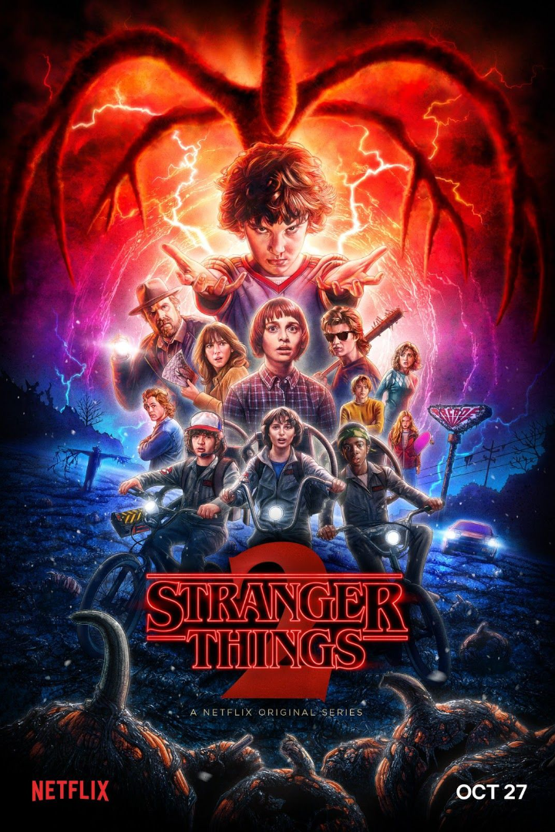
STRANGER THINGS - A SQL CHALLENGE
Content covered:
Introduction.
Tables involved.
Questions & Queries.

Slide 2
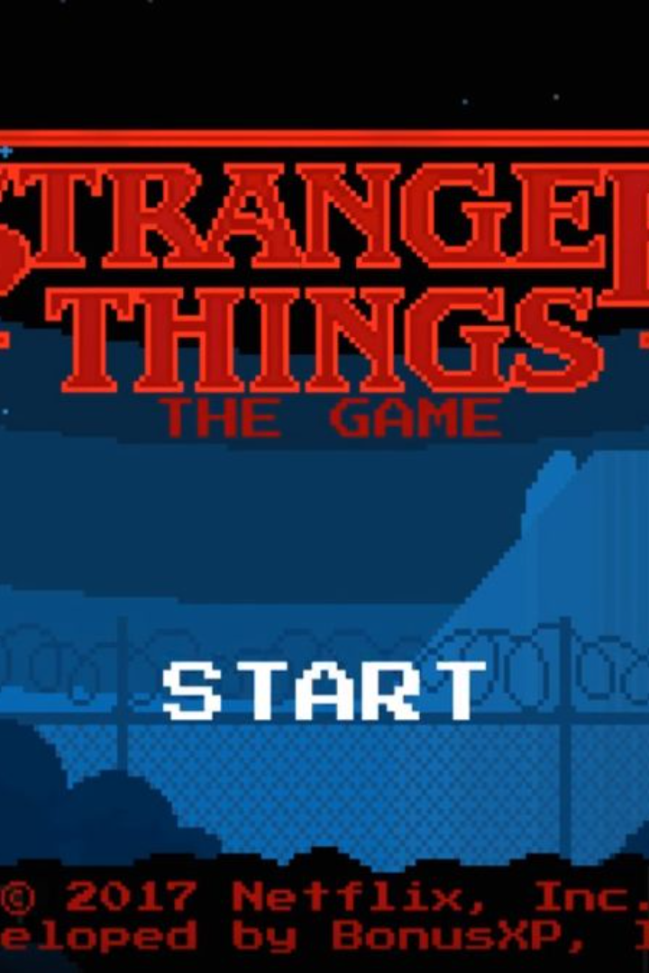
INTRODUCTION TO STRANGER THINGS
Stranger Things is a supernatural horror television series created by the Duffer Brothers. Set in the 1980s, the show pays homage to classic sci-fi and horror movies while telling an original and captivating story.

Slide 3
Main Characters and Their Roles
1. Eleven (Millie Bobby Brown)
The mysterious young girl with psychokinetic abilities, known as Eleven or El.
2. Mike Wheeler (Finn Wolfhard)
Will's best friend, who becomes emotionally connected to Eleven.
3. Joyce Byers (Winona Ryder)
Will's determined and loving mother, who turns to unconventional methods to find him.

Slide 4
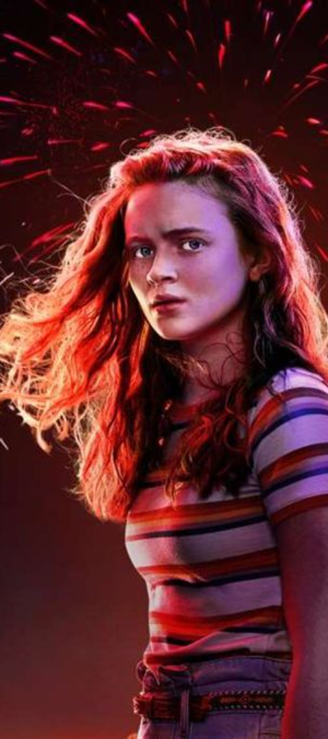
Key Themes and Motifs in the Series
1
Friendship and Loyalty
2
The Power of Childhood
The show emphasizes the unwavering bond of friendship and the lengths friends will go to for each other.
Stranger Things explores the innocence, courage, and resilience of children in the face of extraordinary challenges.
3
Fear of the Unknown
The series delves into the fear of the unknown, as characters confront enigmatic forces beyond their comprehension.

Slide 5
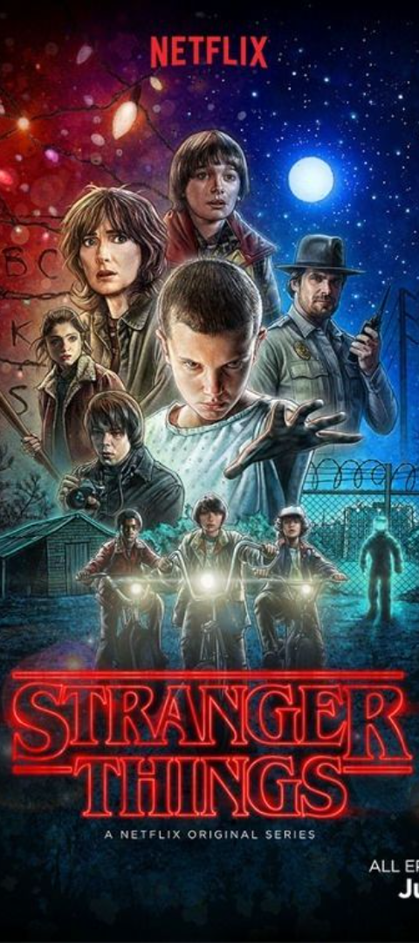
Cultural Impact and Popularity of Stranger Things
Nostalgic Appeal
Fan Engagement
The series evokes a strong sense of 1980s nostalgia, attracting audiences through its retro aesthetic and references to iconic pop culture.
Stranger Things has sparked a dedicated fan base actively involved in discussions, fan theories, and fan art creation.
Global Phenomenon
The series has garnered international acclaim, transcending cultural boundaries to resonate with diverse audiences worldwide.

Slide 6
TABLES INVOLVED IN THE DATA
CHARACTERS
LOCATIONS
EVENTS
RELATIONSHIPS
MONSTERS

Slide 7
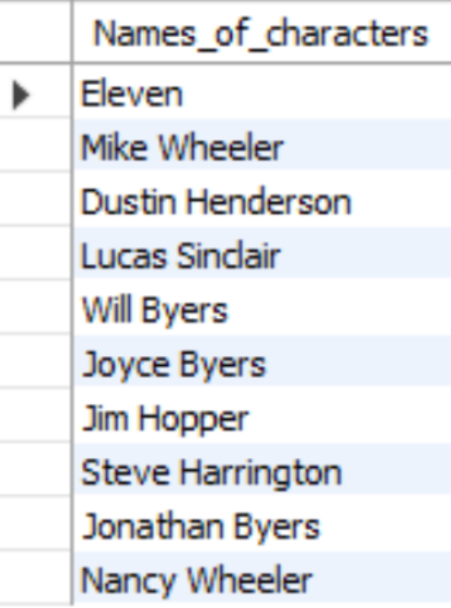
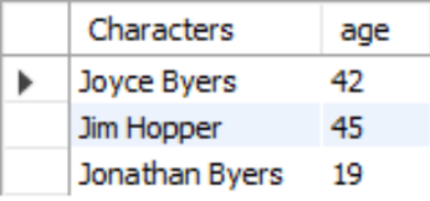
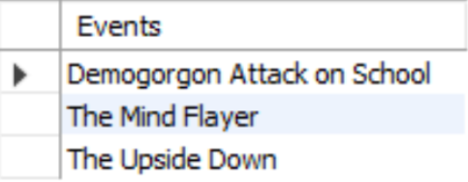
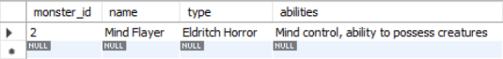
QUESTIONS AND QUERIES
Retrieve the names of the characters?
2. Find characters with age greater than 18?
3. Find events in Season 2?
4.Get details of the 'Mind Flayer' monster?

Slide 8
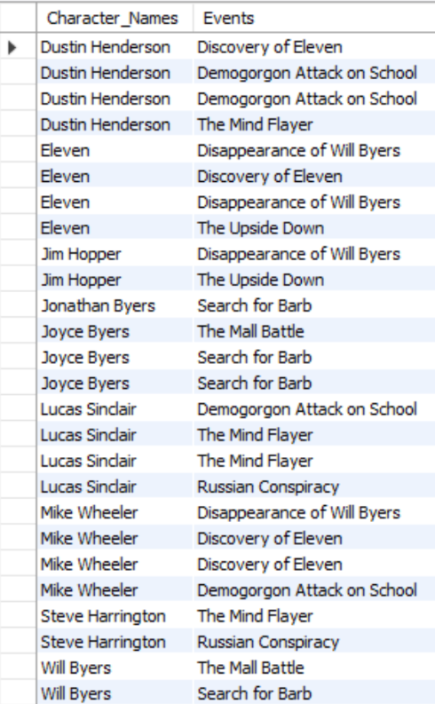
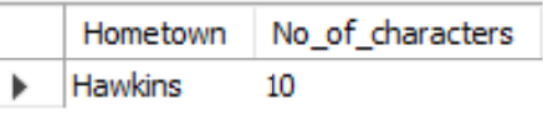
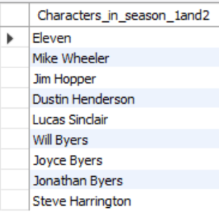
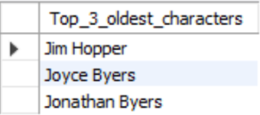
5. Retrieve characters and their associated events?
6. Calculate the total number of characters from each hometown?
7. Retrieve characters who were involved in events in Season 1 or Season 2?
8. Find the top 3 oldest characters?

Slide 9
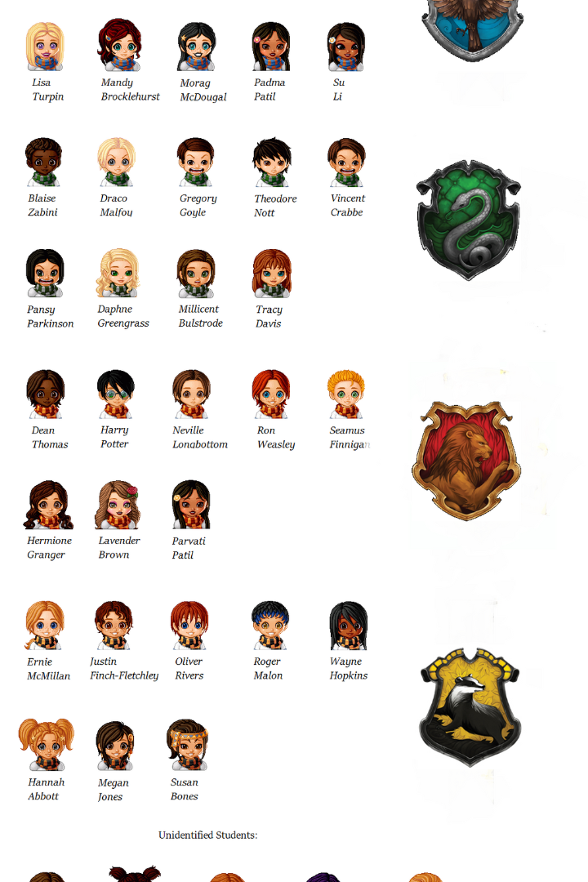
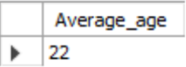
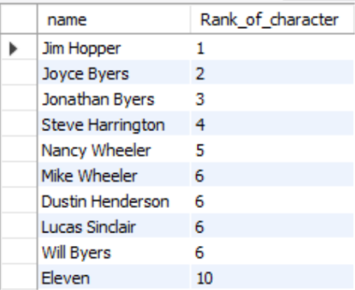
9. Find the average age of characters in Hawkins?
10. Rank characters by age in descending order?

Slide 10

THANKS FOR VIEWING

